Slide 1






Anchored Diffusion Language Model
NeurIPS 2025
Litu Rout, Constantine Caramanis, and Sanjay Shakkottai
The University of Texas at Austin, Google
Notes:
Hi everyone, my name is Litu Rout. I am a fourth year phd student at UT Austin, co-advised by Prof. Constantine Caramanis and Prof. Sanjay Shakkottai. Today, I'm going to present our work on Anchored Diffusion Language Model.

Slide 2
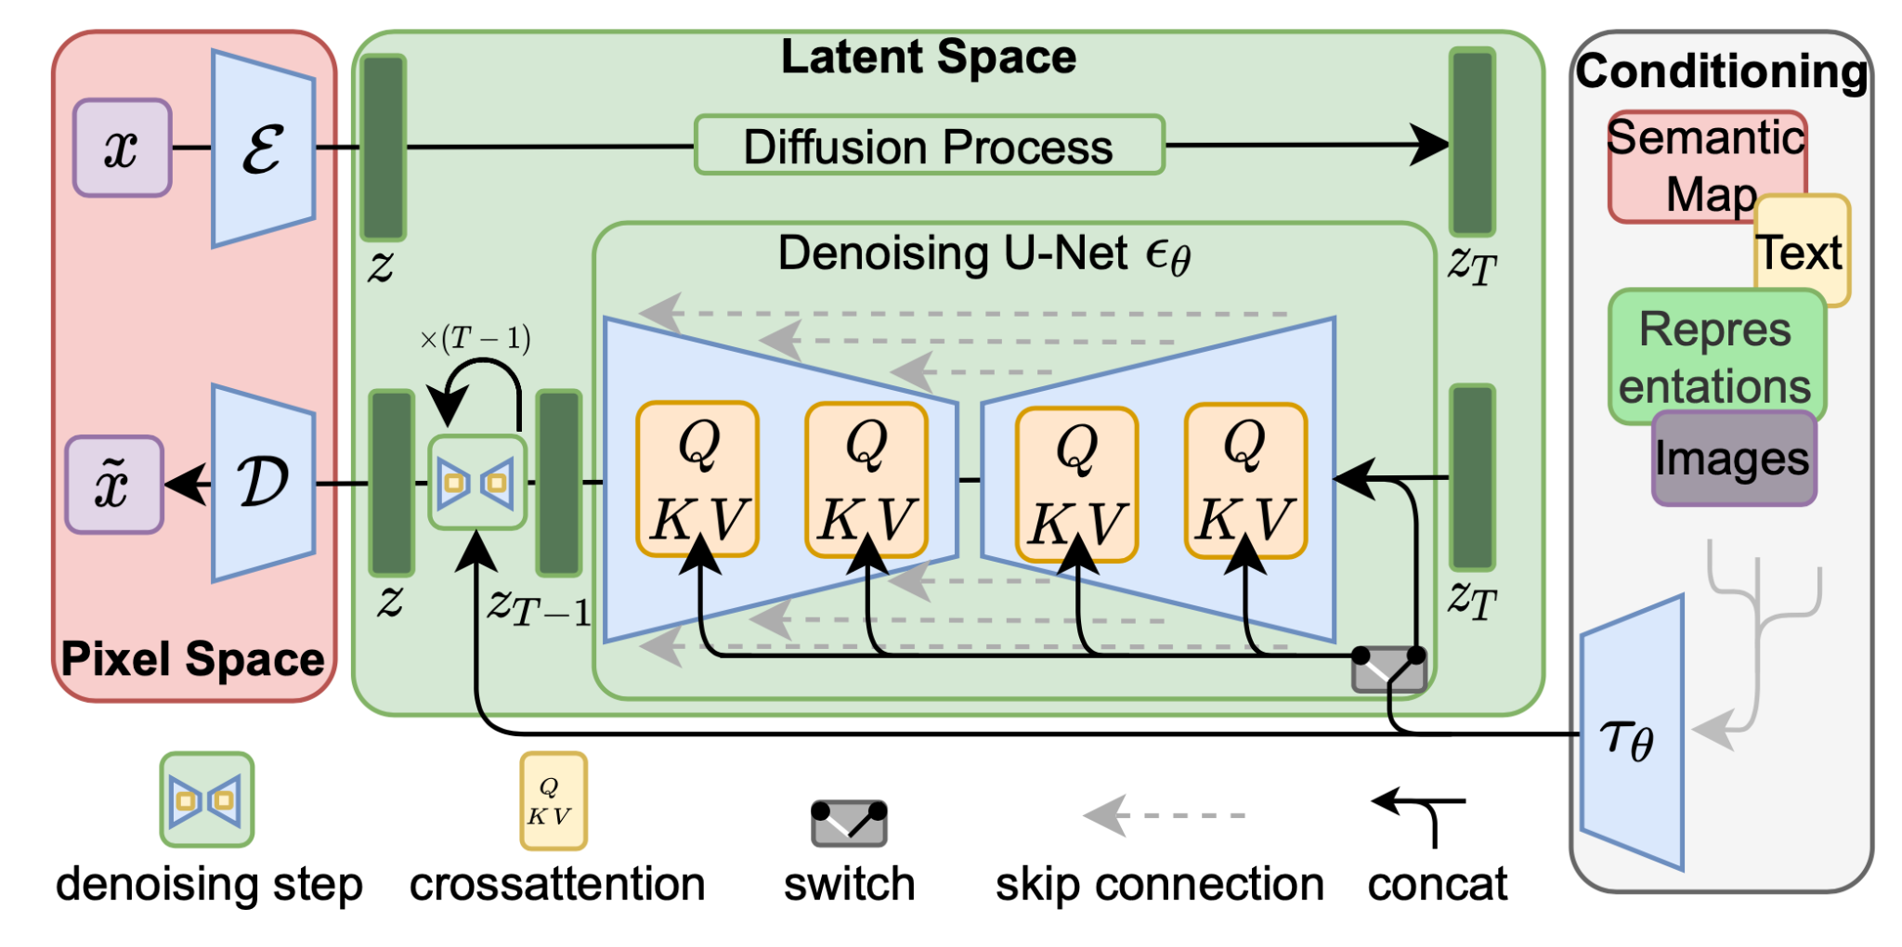
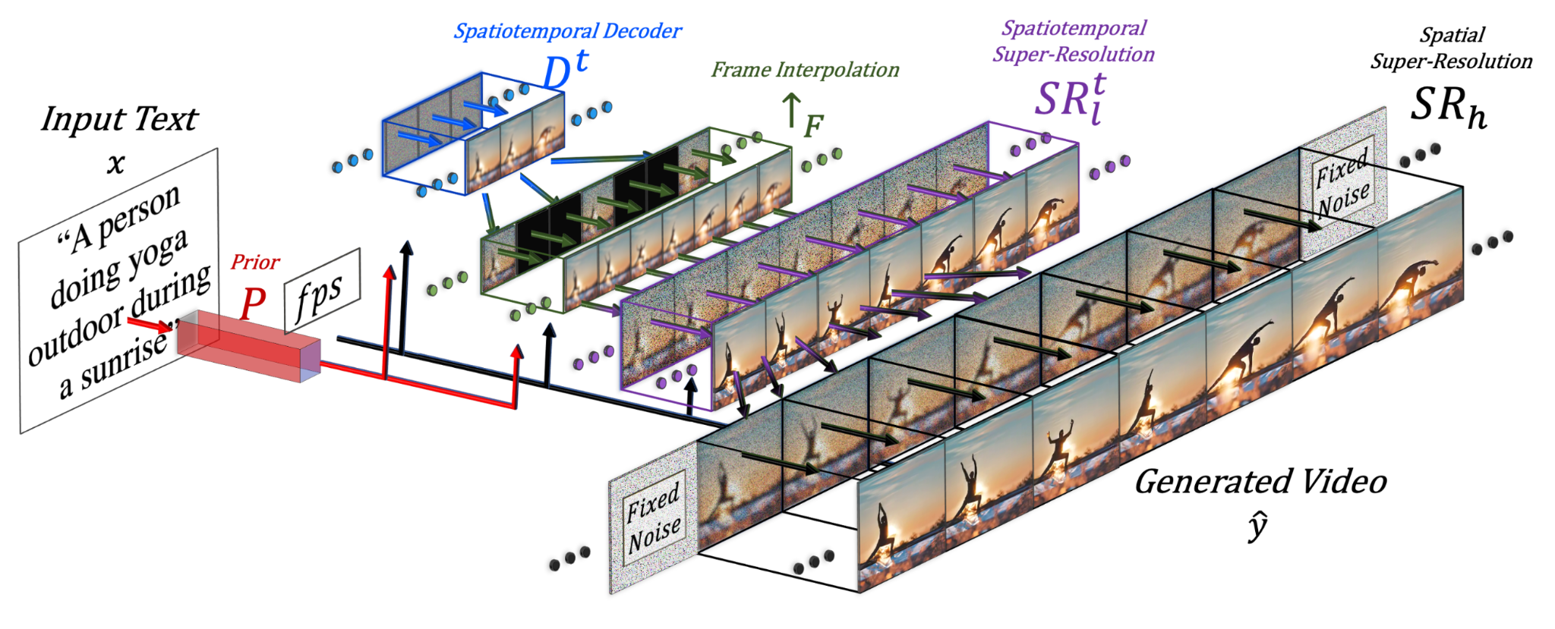
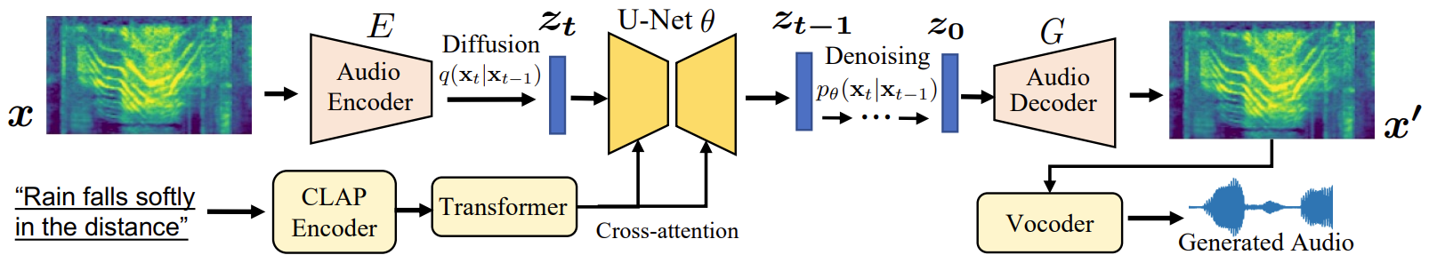
Generative Modeling with Diffusion
Diffusion Model for Images
Diffusion Model for Video
Diffusion Model for Audio
[1] Image: https://arxiv.org/pdf/2112.10752 [2] Audio: https://text-to-audio.github.io/ [3] Video: https://arxiv.org/pdf/2209.14792
Notes:
Diffusion models have been very successful in generative modeling of images, video, audio and in many other applications.

Slide 3

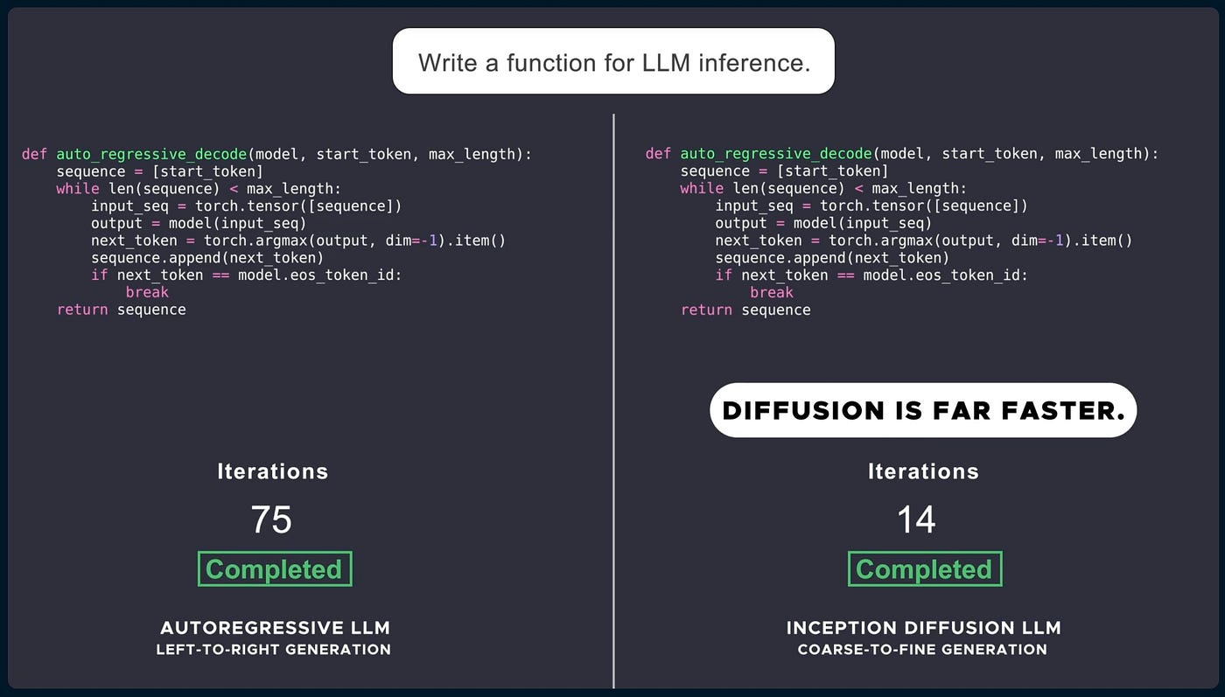
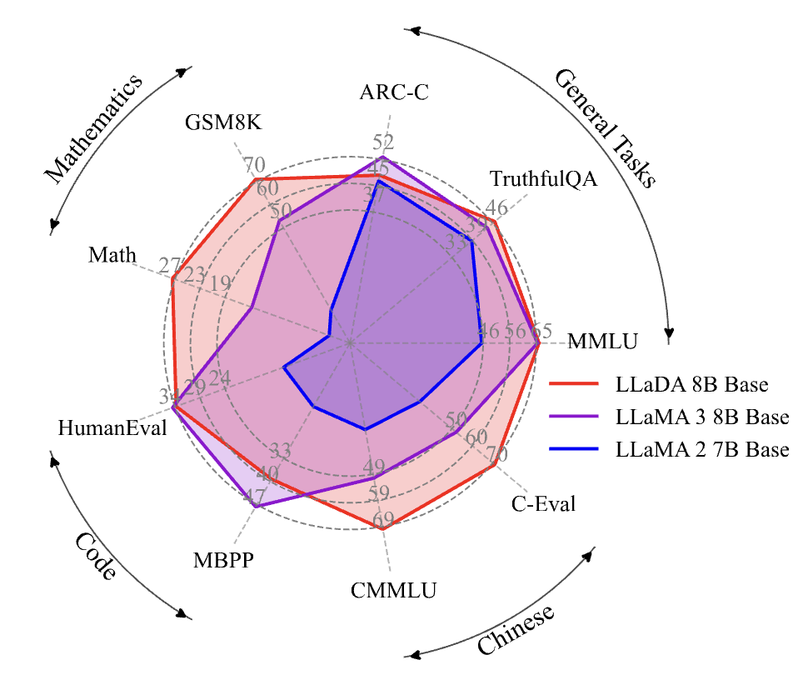
Large-Scale Diffusion Language Models
Gemini Diffusion
Mercury
Can be more accurate
Significantly faster
LLaDA
Gemini Diffusion: https://deepmind.google/models/gemini-diffusion/
LLaDA: https://arxiv.org/abs/2502.09992
Mercury: https://www.inceptionlabs.ai/
Notes:
Recent methods such as Gemini Diffusion, LLaDA and Mercury have shown that diffusion models can also be used for language modeling. Now, why should we care of diffusion language models while autoregressive models are already doing so well.
There are several reasons to it. One of those reasons is that Diffusion models can be more accurate.
Another reason is that diffusion is significantly faster compared to autoregressive models.

Slide 4
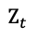
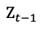
Standard Approach: Masked Diffusion Language Model
$$Z_{t−1}$$
a
mask
is
playing
with
mask
mask
64
50257
318
1760
326
50257
50257
Denoising Transformer
(with bidirectional attention)
$$Z_{t}$$
64
50257
318
50257
326
50257
50257
a
mask
is
mask
with
mask
mask
Denoising Transformer: Unmasks using already unmasked tokens
Our approach: Improve context using semantically important tokens
D3PM: https://arxiv.org/abs/2107.03006 MDLM: https://s-sahoo.com/mdlm/ MD4: https://arxiv.org/abs/2406.04329
Notes:
Now, let's look at the inference pipeline of a typical masked diffusion language model. [N] we start with a sequence of partially unmasked tokens. [N] That goes in as input to the denoising transformer [N] which unmasks a few more tokens [N]
In this case, the model chose to unmask the work playing and the model made the decision about unmasking the word playing by looking at the already unmasked words in its context. Note here that this context is not very informative to the word playing. Given "a", "is" and "with", there are so many words that can go in that position. So it becomes difficult for the denoising transformer to choose one word.

Slide 5
Our Approach: Anchored Diffusion Language Model
$$Z_{t−1}$$
a
cat
is
playing
with
mask
dog
64
349
318
1760
326
50257
329
Denoising Transformer (with bidirectional attention)
a
cat
is
dog
mask
mask
mask
with
mask
mask
Anchor Transformer (with bidirectional attention)
$$Z_{t}$$
64
50257
318
50257
326
50257
50257
a
mask
is
mask
with
mask
mask
Anchor Transformer: Outputs a sequence of anchor predictions
- Mixture of important tokens interpreted as soft samples
Denoising Transformer: Unmasks tokens using anchored predictions
Notes:
Now, let's see how our approach works.
We start with the same partially unmasked sequence of tokens.
Instead of feeding that as inputs to the denoising transformer, we feed that as input to something we call anchor transformer.
Anchor transformer outputs a sequence of anchor predictions, which are mixtures of important tokens. We can interpret these as soft samples in the latent reasoning space.
The anchored predictions go as inputs to the denoising transformer
which then unmasks a few more tokens.
Now, the anchored predictions contain the soft samples or the key words such as cat and dog which have been added to the context of the denoising transformer.
When we condition the denoising transformer on these anchor tokens, the number of possible word choices for the position of the word playing is much less compared to the standard approach.
Therefore, our approach can easily unmask tokens based on these anchored predictions, unlike the standard approach that relies only on the unmasked tokens.

Slide 6
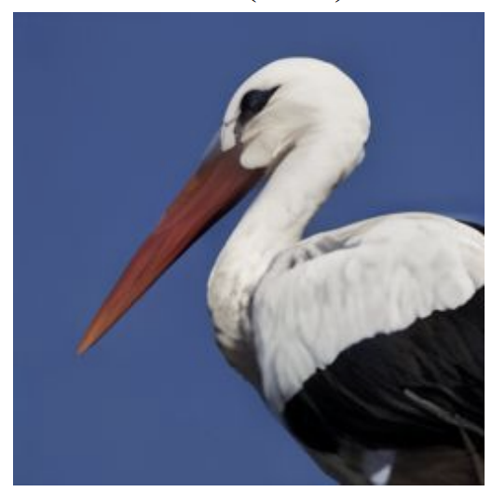
Our Key Idea: Anchoring
Anchors: Tokens whose inclusion as conditioning variables yields a substantial reduction in the conditional entropy of the remaining tokens
Examples:
1. To decode the sentence: “a cat is playing with a dog”
- Tokens ‘cat’ and ‘dog’ are more useful than ‘a’ or ‘is’
2. To solve the math question: “Janet’s ducks lay 16 eggs per day. She eats three for breakfast every morning and bakes muffins for her friends every day with four. She sells the remainder at the farmers' market daily for $2 per fresh duck egg. How much in dollars does she make every day at the farmers' market?”
- Numbers ‘16’, ‘three’, ‘four’, and ‘2’ are more useful than ‘breakfast’ or ‘muffins’
3. To reconstruct the image:
- Tokens in the beak or body (foreground) are more useful than tokens from blue background
Credit: Math question from the GSM8K dataset
Notes:
Now, what are the anchor predictions or anchor tokens? We define anchor tokens as the tokens that reduce the conditional entropy of the remaining tokens in the sequence.
For example, knowing the words "cat" and "dog" reduces the number of possible word choices at other positions, which is equivalent to reducing their conditional entropy.
Similarly, to solve the math question, knowing the numbers is more useful than the words "breakfast" or "muffins"
to reconstruct the image, the tokens in the body of the bird are more useful than the tokens in the background.

Slide 7
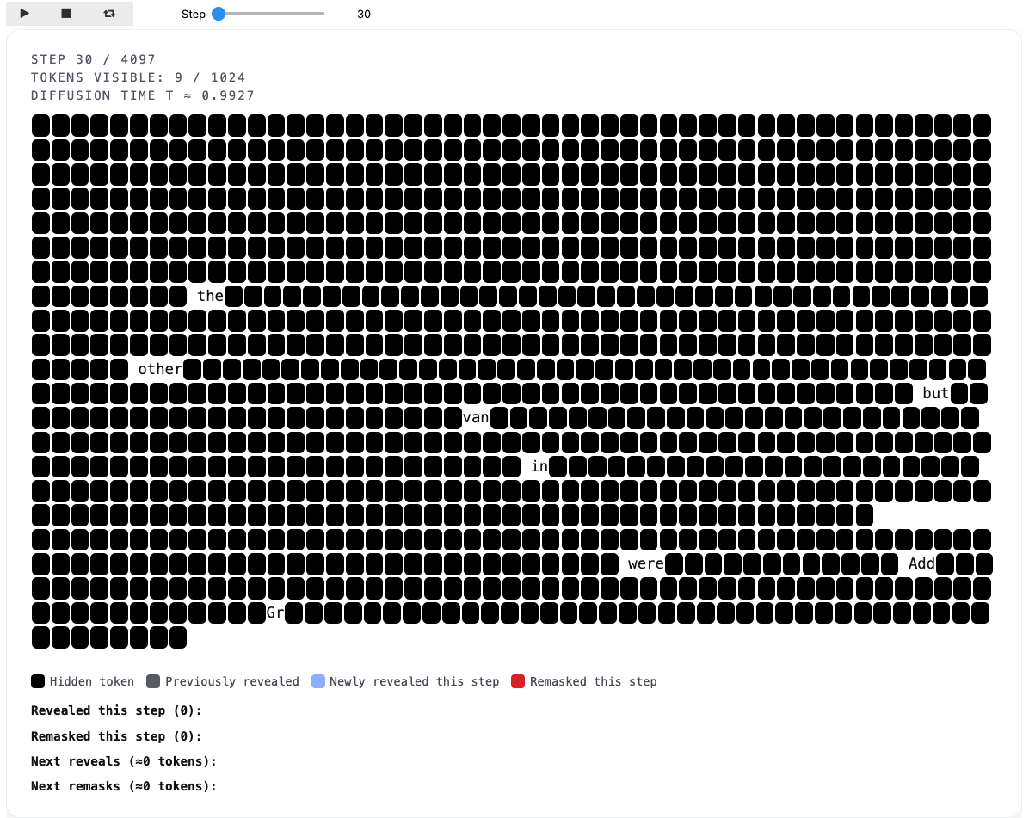
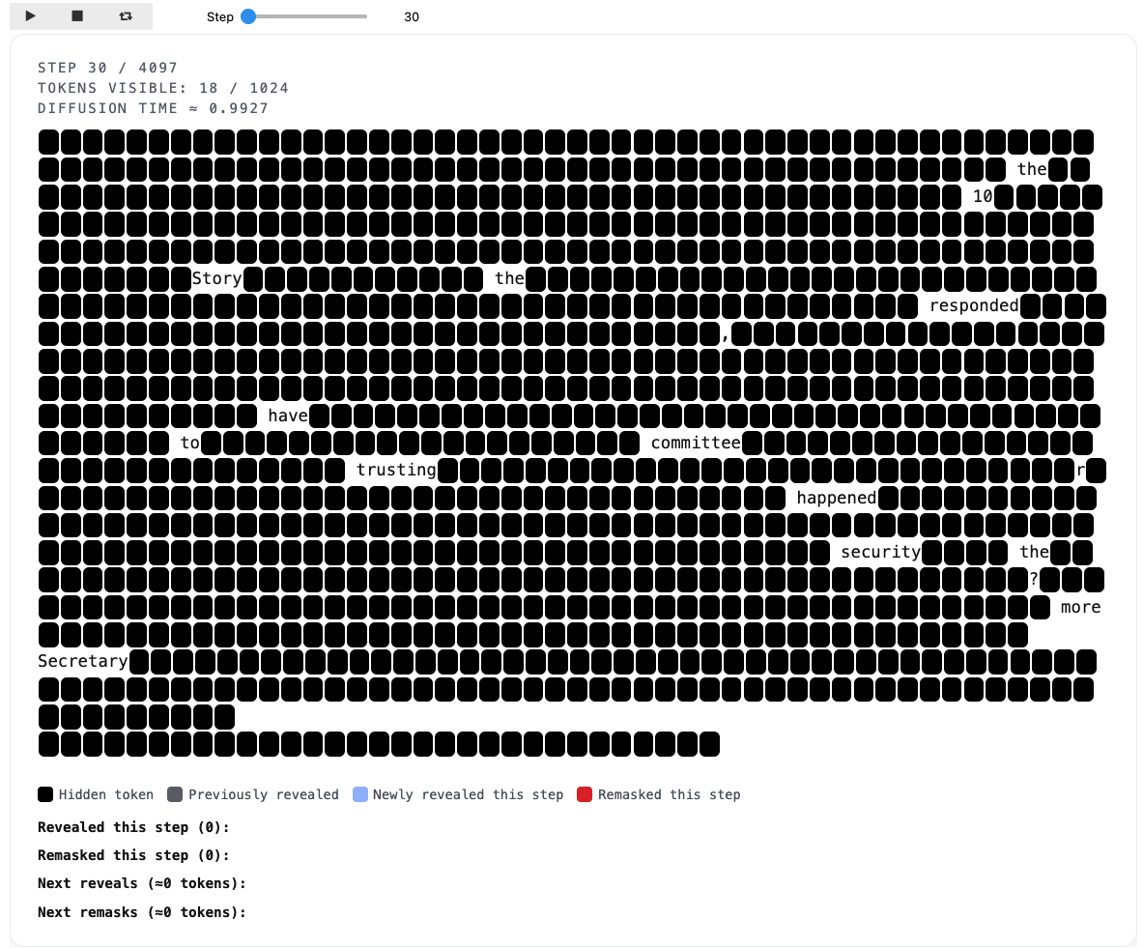
Masked DLM vs Anchored DLM – Inference Illustration
Anchoring has 2 main advantages:
unmasks key words first
unmasks many tokens in parallel
MDLM at time-step 30 / 4097
ADLM at time-step 30 / 4097
Notes:
Here is a real inference example of Masked DLM versus anchored DLM.
Anchoring offers two advantages:
1. it unmasks the important tokens early in the reverse process
2. this helps the denoising transformer unmask many tokens in parallel.

Slide 8
Anchored Autoregressive Model: Training and Inference
[BoA]
16
3
[EoA]
[BoR]
<<16 – 3 – 4 = 9 >> <<9 * 2 = 18>>
[EoR]
18
Tokens
Language Model Head
Anchoring enables “look-ahead” planning, unlike the standard left-to-right decoding of chain-of-thought (CoT) reasoning
Embeddings
Anchor Transformer (with causal attention)
…
Embeddings
[BoA]
[EoA]
[BoR]
<<16 – 3 – 4 = 9 >> <<9 * 2 = 18>>
[EoR]
Tokens
Janet’s ducks lay 16 eggs per day. She eats three for breakfast every morning and bakes muffins for her friends everyday with four. She sells the remainder at the farmers’ market daily for $2 per fresh duck egg. How much in dollars does she make every day at the farmers’ market?
During Supervised Fine Tuning of LLM
[BoA]
[EoA]
[BoR]
<3+4=7> <16-7=9> <9*2=18>
[EoR]
18
Tokens
Language Model Head
Embeddings
Anchor Transformer (with causal attention)
During LLM Inference
…
Embeddings
[BoA]
[EoA]
[BoR]
<3+4=7> <16-7=9> <9*2=18>
[EoR]
Tokens
Notes:
Beyond diffusion, we extend anchoring to autoregressive models. We show superior performance in anchored autoregressive training and also in anchored chain-of-thought finetuning.
Our important observation is that anchoring enables look-ahead planning or out-of-order reasoning unlike standard chain-of-thought methods.

Slide 9

📄 Paper: openreview.net/pdf?id=E8adS5srd 🌐 Project Page:
anchored-diffusion-llm.github.io 💻 Source Code: github.com/LituRout/ADLM
Notes:
Please stop by our poster to know more about our work and try generating text using our opensource code.

